Slide 1

Data Science 103
Databases

Slide 2
Schedule
 | Title | Description | Exercise
1 | Python 101 | Intro to syntax and core concepts | Python workbook
2 | Data Analysis | Analysis libraries (numpy and pandas) | CO2 Analysis
3 | Databases | DB storage and SQL | Build own database
4 | Visualisation | Sexy graphs, charts, and wordclouds | Colourful visualisation
5 | Machine Learning | Simple models | Regression & Decision Trees?
6 | Machine Learning | Complex models | Visual recognition
7 | Watson Integration | Integrating with Watson cloud services | Watson labs

Slide 3
Outline
What is SQL
SQL Commands
Create our own DB
Get stuff out of our DB
In IBM Cloud
In Python

Slide 4
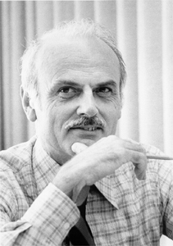

Blame IBM
‘Structured Query Language’
Based on Edgar Codd’s ‘Relational Model’ from 1970(?!)
Commercial language for handling structured data
Only nerds care if you pronounce it ‘S.Q.L.’ or ‘Sequel’
Great at structured data in relational DBs
Less good for unstructured stuff
Various feature extensions over the decades but largely unchanged
Notes:
New features since 1990s. Regex, recursive queries, stored procedures, some object-orientation, integration with other languages like Java (1999). JSON management in 2016

Slide 5
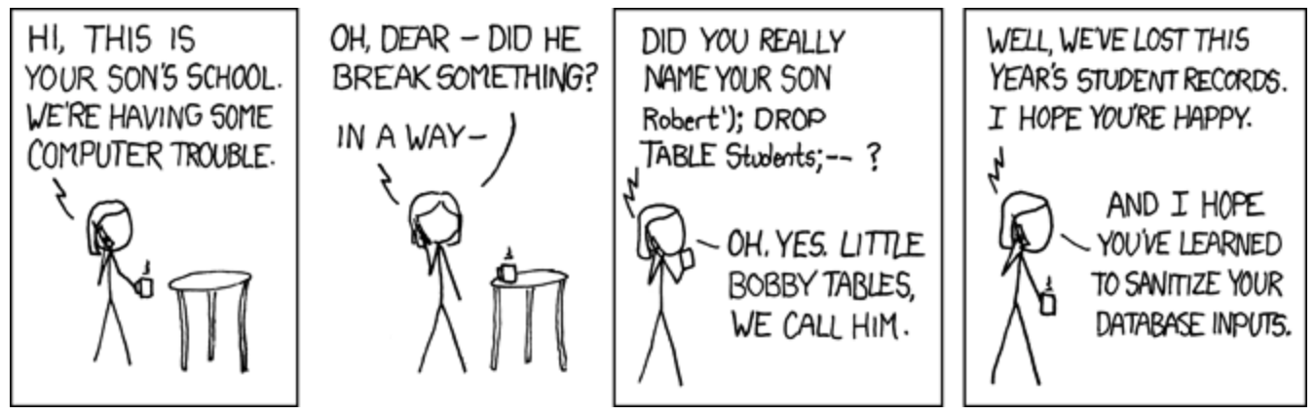
Basic Commands
Not that much to it and super literal
The big ones are:
SELECT - extracts data from a database
UPDATE - updates data in a database
DELETE - deletes data from a database
INSERT - inserts new data into a database
CREATE DATABASE - creates a new database
ALTER DATABASE - modifies a database
CREATE TABLE - creates a new table

Slide 6
SQL and Python
External libraries required
Little bit fiddly
Create connection
Declare statement
Run statement against connection
Convert SQL table into something useful like a pandas dataframe

Slide 7
Today’s Lab
Design a database structure
Create a DB2 service in IBM Cloud
Create our tables
Populate tables
Query tables

Slide 8
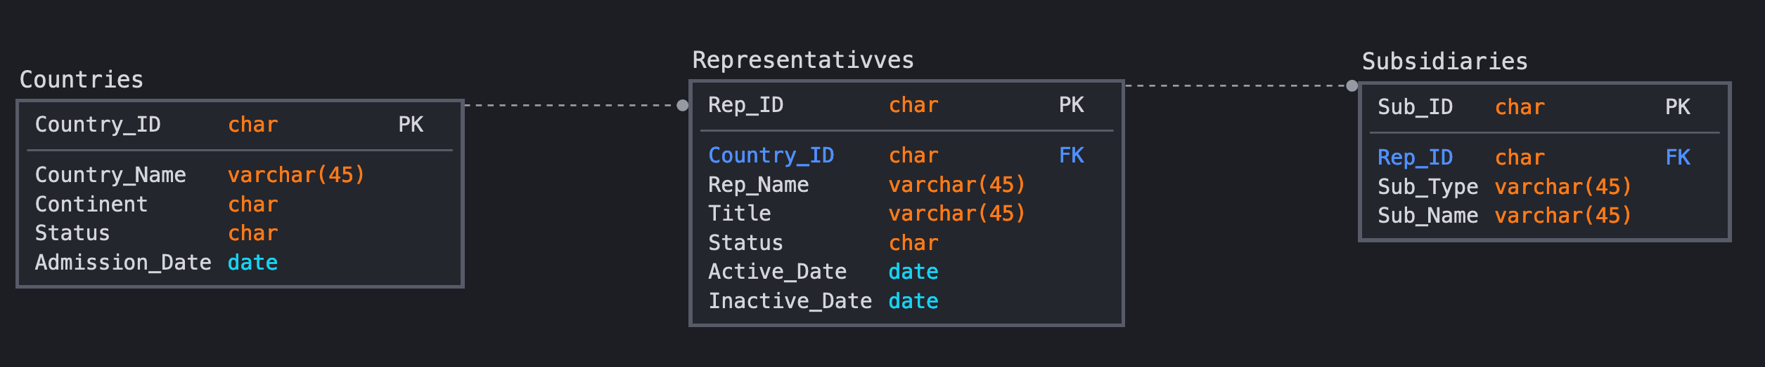
Model (the) UN

